Slide 1
MECHANISM OF COUGH
&
COUGH SOUNDS WITH DIFFERENT DISEASES

Slide 2
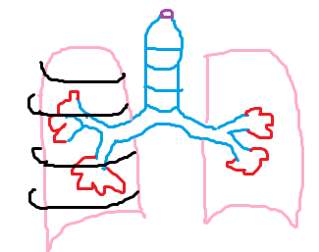
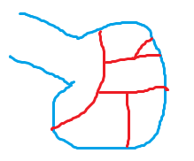
Lung Anatomy
Airway
Air sac

Slide 3
Lung Anatomy
Epiglottis
Bronchi
Trachea
Alveoli
Ribs
Bronchioles
Blood capillaries

Slide 4
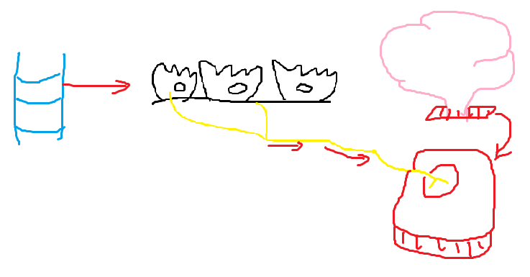
Cough Mechanism
1. Receptorial phase
Brain
Muscular cells
Trachea
Vagus nerve
Medulla

Slide 5
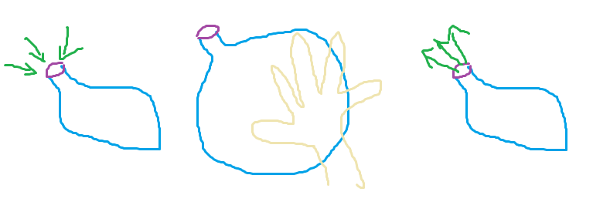
Cough Mechanism
Epiglottis close
Epiglottis Open
Breath in
2. Inspiratory
phase
3. Compressive
phase
4. Expiratory
phase

Slide 6
Cough sounds in different diseases
Airway
Air sac

Slide 7
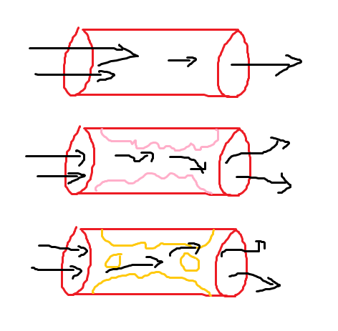
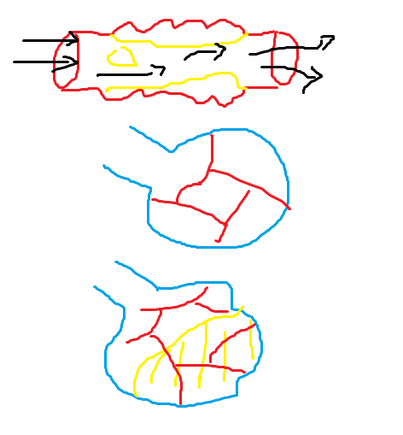
Normal airway
Widened airways
Stiff lungs
Narrowed airways
Fluid filled lungs

Slide 8

What about Covid – 19 cough sound?

